Slide 1
Accra, 4 October 2017

Slide 2
WHAT CHALLENGES WILL WATERSHED ADDRESS?
CSO LOBBY AND ADVOCACY
Coordination of decentralised service delivery
Full integration of WASH and WRM.
Evidence-based decision making to inform implementation decisions.
Equitable financing of WASH and WRM.
Reaching the unserved.
Civil society organisations need capacity to influence WASH and WRM policy.

Slide 3
WHO WE ARE WORKING WITH IN GHANA
CSO LOBBY AND ADVOCACY
Hope for Future Generations
Conservation Foundation
CONIWAS
Ghana WATSAN Journalists Network
Resource Centre Network
FOCAL DISTRICT
Tarkwa Nsuaem Municipal Assembly, Western Region, Ghana

Slide 4
GHANA WP OUTCOMES
CSO LOBBY AND ADVOCACY
CSOs have and use evidence to influence government to prioritize WASH and IWRM integration at all levels.
Citizens are able to make clear demands to the service providers and district authority and hold them accountable for improved WASH services.
CSOs and Government strengthen coordination through dialogue, joint planning and programming for sustainable WASH and IWRM integration.
National and district governments prioritize WASH and IWRM integrated financing.

Slide 5
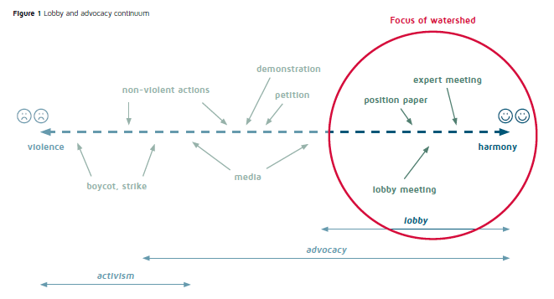
POLICY INFLUENCING METHODS
CSO LOBBY AND ADVOCACY

Slide 6
ACTIVITIES
CSO LOBBY AND ADVOCACY
Capacity Strengthening
Lobby and Advocacy - For partner organizations to outline different advocacy and influencing styles, advocacy priorities for each Watershed partner ; Data gathering for evidence for lobby and advocacy
Lobby and Advocacy
Engage government national and district in dialogue on prioritized thematic areas; WASH & IWRM prioritization through print, online , TV and Radio; Support lobby and advocacy sessions during sector events
Research and Knowledge Management
Generate evidence on thematic areas for L&A – briefing papers, factsheets, reports etc

Slide 7
LEARNING TRAJECTORIES
CSO LOBBY AND ADVOCACY
WASH and Water security (IWRM/WASH integration)
Leave no-one behind (Social Inclusion)
Policy influencing (Lobby & Advocacy):
Data analysis for evidence-based L&A
Finance and budget tracking

Slide 8
VISIT US:
CSO LOBBY AND ADVOCACY
http://watershed.nl/

